Slide 1

Advances in Digital
Signal Processing
---Matlab Exercise
Lecturer: Yuan Chen
Department of Communication Engineering
University of Science and Technology Beijing

Slide 2

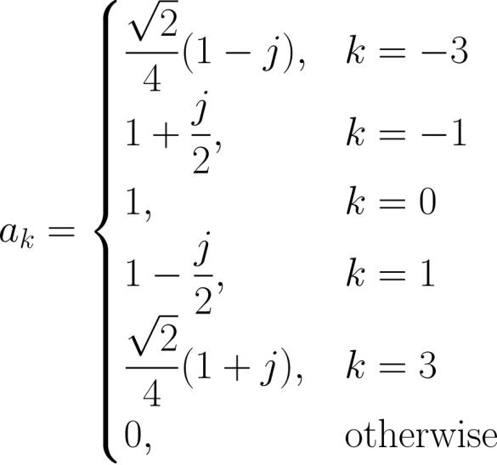
主观题
10分
Please plot the Fourier series coefficients for
which is
作答

Slide 3
Answer:
k=[-3 -1 0 1 3];
a_k=[sqrt(2)/4*(1-j) 1+j/2 1 1-j/2 sqrt(2)/4*(1+j)];
figure
subplot(211)
stem(k,abs(a_k)),hold on
xlabel('k')
ylabel('Magnitude of |a_k|')
subplot(212)
stem(k,phase(a_k)),hold on
xlabel('k')
ylabel('Phase of a_k')

Slide 4






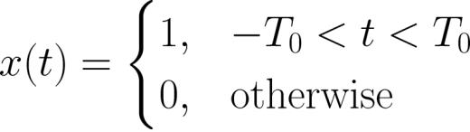

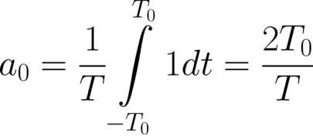

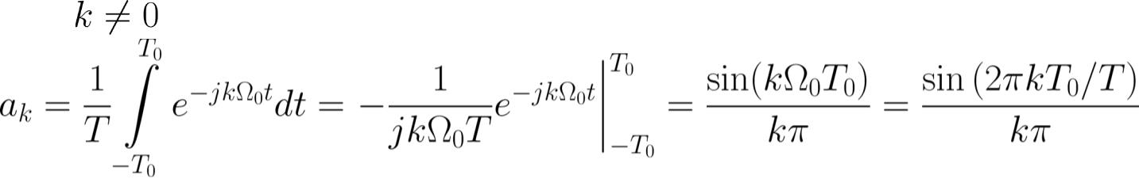

Homework
Find the Fourier series coefficients for , which is a
periodic continuous-time signal of fundamental period and
is a pulse with a width of in each period. Over the
specific period from
to , is:
with
.
For :
For :
Page 10
Semester A, 2022-2023

Slide 5
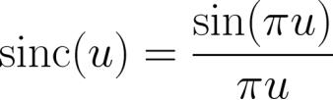
Matlab
T = 20;
T_0= 5;
k=-10:1:10;
a_k = sin(2*pi*k*T_0/T)./(k*pi);
a_k(11)=2*T_0/T;
subplot(211)
stem(k,abs(a_k)),hold on
xlabel('k');
ylabel('|a_k|')
a_k=2*T_0/T*sinc(2*k*T_0/T);
subplot(212)
stem(k,abs(a_k)),hold on
xlabel('k');
ylabel('|a_k|')

Slide 6
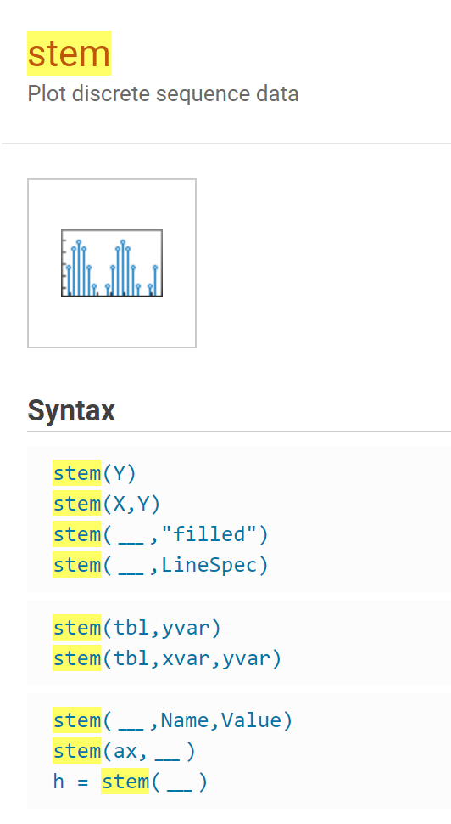
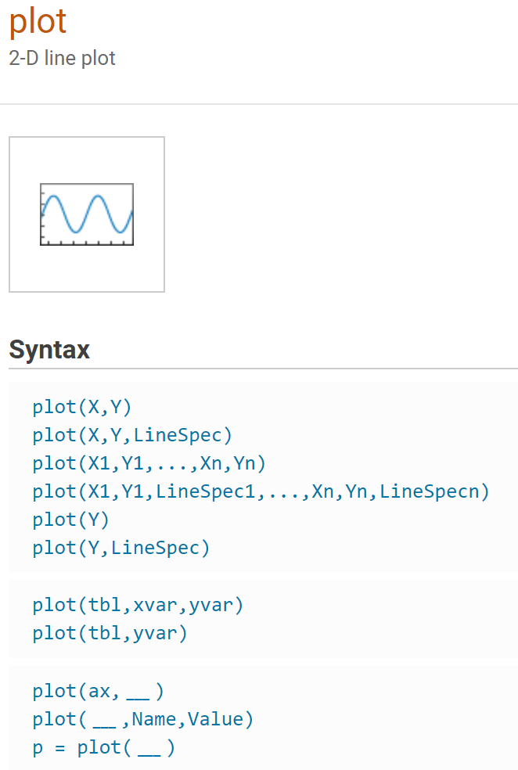

Slide 7

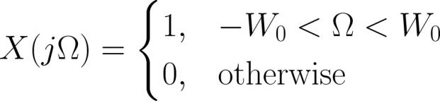
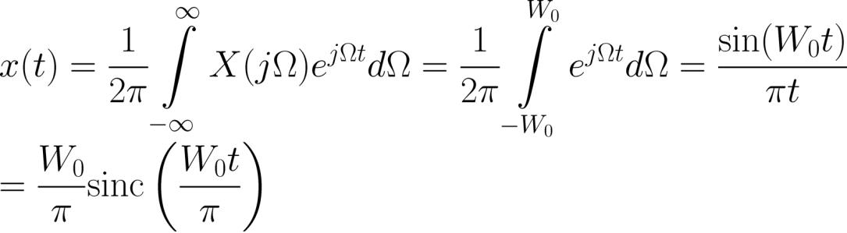
Example 2.5
Find the inverse Fourier transform of
which is a
rectangular pulse of the form:
Using (2.9), we get:

Slide 8
Matlab
W_0= 0.2*pi;
T = 20;
dt = 0.1;
t=-T:dt:T;
x=2*W_0/pi*sinc(W_0*t/pi);
plot(t,x),hold on
xlabel('t');
ylabel('|x|')

Slide 9
Ex.
Please plot figures 7.4-7.5 using Matlab

Slide 10
Ex
Try to plot the DFT spectrum of
x=[A*cos(w.*n+p) zeros(1,1980)];
Where
A = 2;w = 0.7π;
p is a random variable following uniformly distribution in (0,1);
n= 0,1,2,….20

Slide 11
Ex
Given a discrete-time finite-duration sinusoid:
Estimate the tone frequency using DFT.

Slide 12
Ex
Use the window method to design a linear-phase and causal FIR filter of length 101 such that the sampled version of a continuous-time sinusoid with frequency of 160 Hz can pass through it with negligible attenuation while the sampled signal corresponds to a tone of frequency 240 Hz will be suppressed. The sampling frequency is 2000 Hz.

